Slide 1

R Helper Package for Applied Linear Regression
Authored by Cameron McClellan and Garrett Saunders

Slide 2
Purpose
Two main goals:
Help MATH425 students
Simplify visualizing high dimensional models

Slide 3
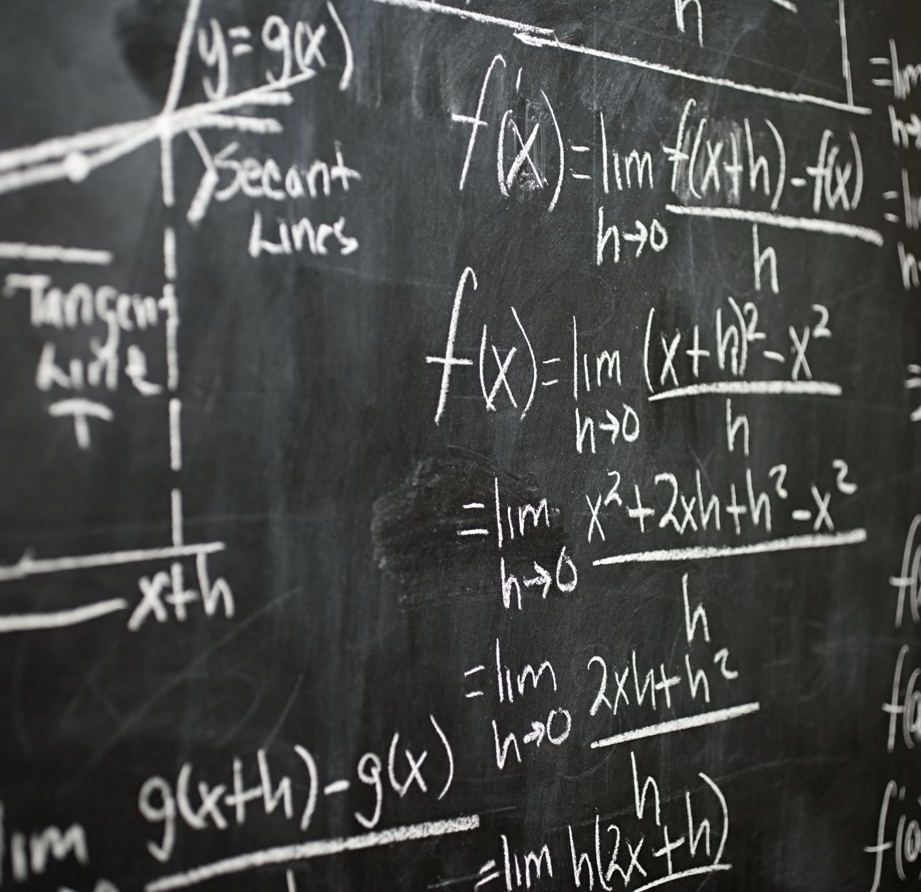
FUNCTIONS

Slide 4
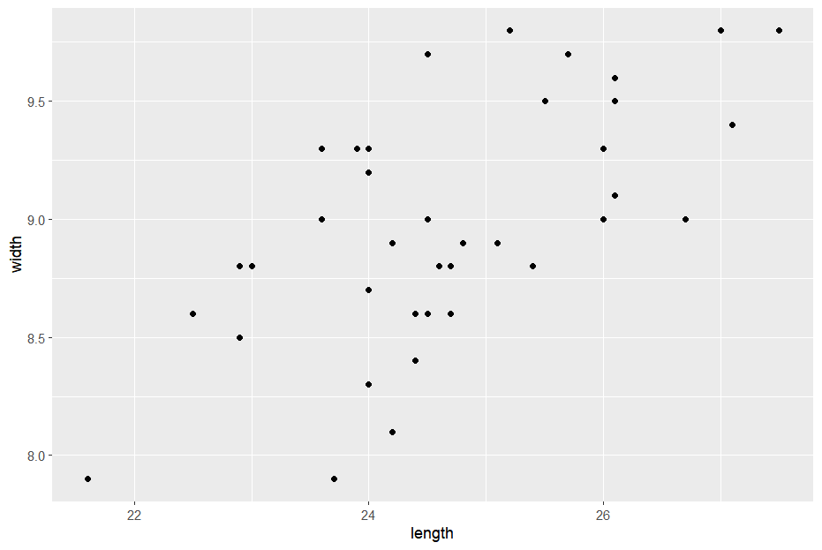
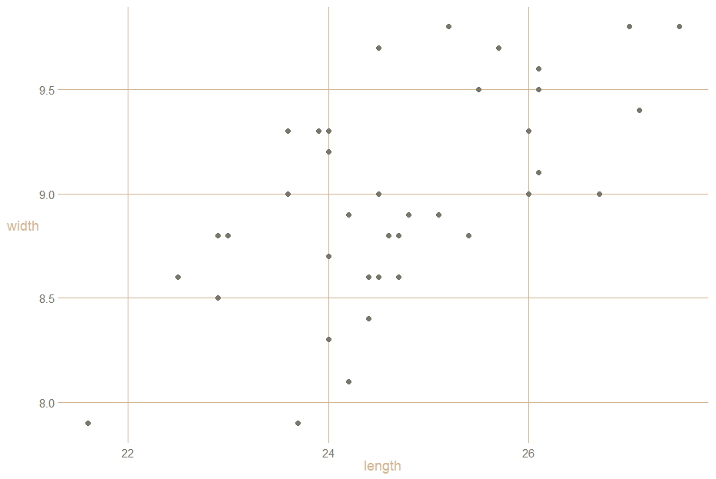
theme_lc:
A custom ggplot theme that modifies the visual aesthetics of a graph.
After:
Before:

Slide 5


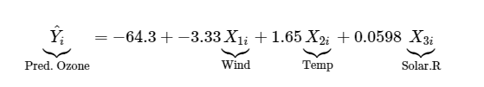
lm_equation and lm_latex
lm_equation:
Returns the equation of a function – including variable names. Useful for those trying to understand how each variable of a model affects the overall outcome.
lm_latex:
Returns the equation of a function in latex format – making it easy to display equations in html formatting.

Slide 6
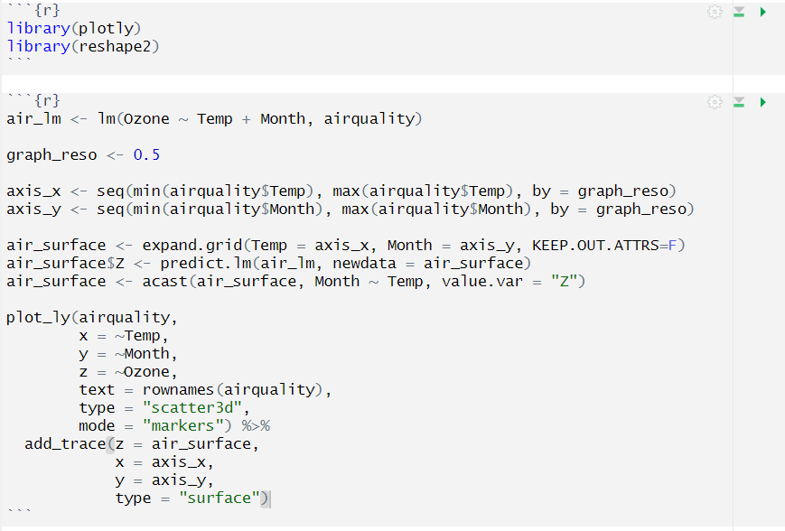
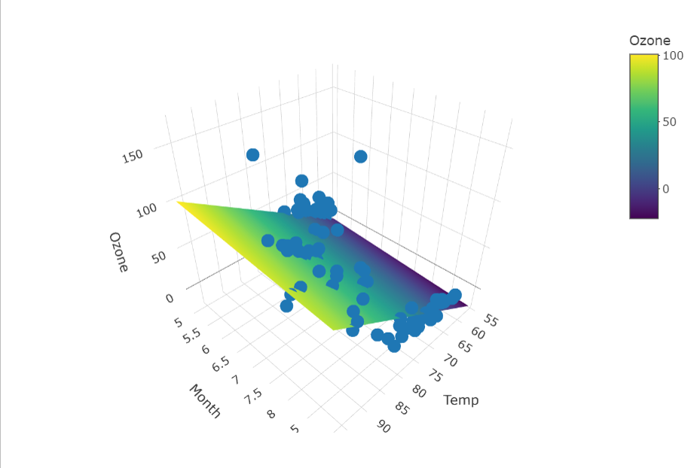
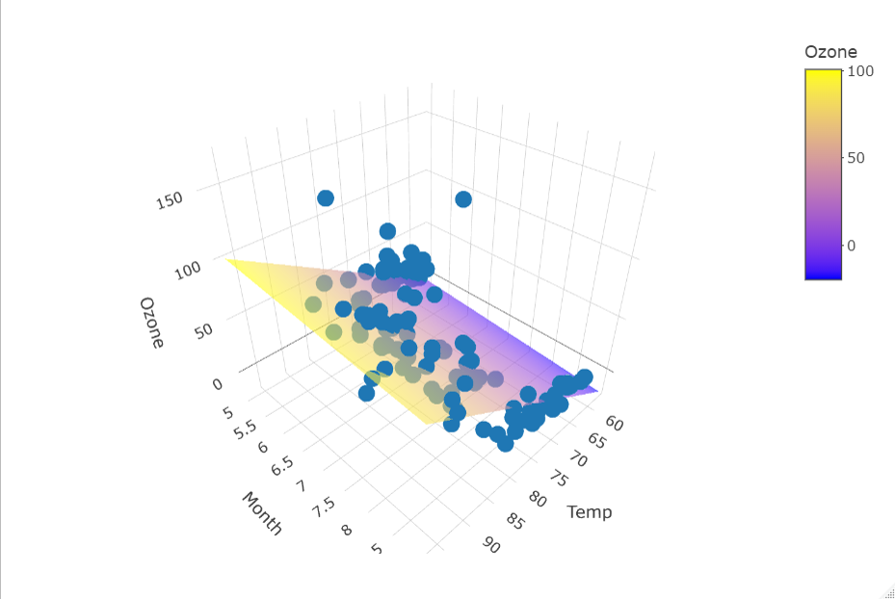
scatter_3d:
A function designed to make 3D modeling easier
Before:
After:

Slide 7


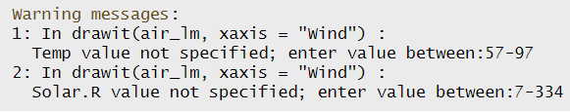
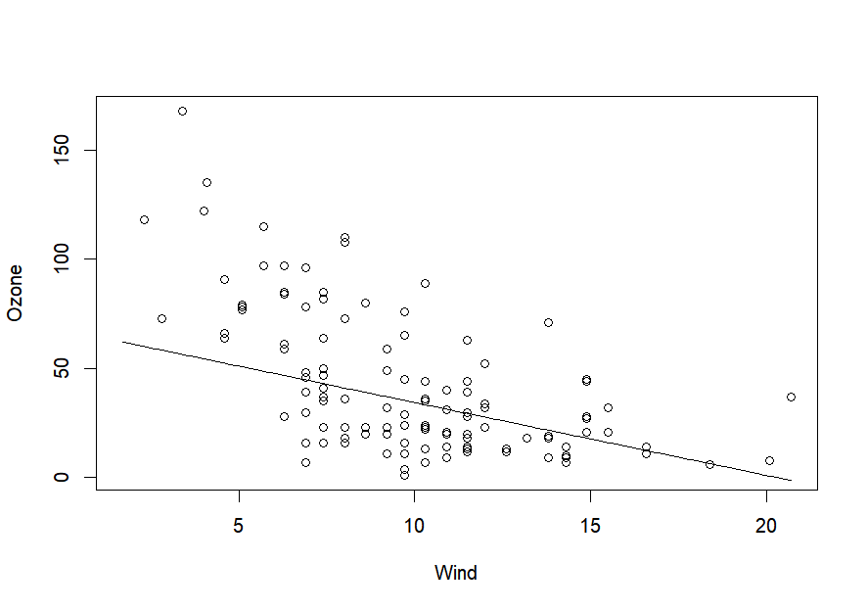
draw_it:
A function designed to help graph custom slices of a model. Fully customizable and requires that students input values for variables within the model.
Input not complete:
Proper input:

Slide 8
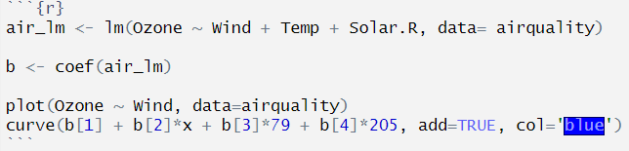

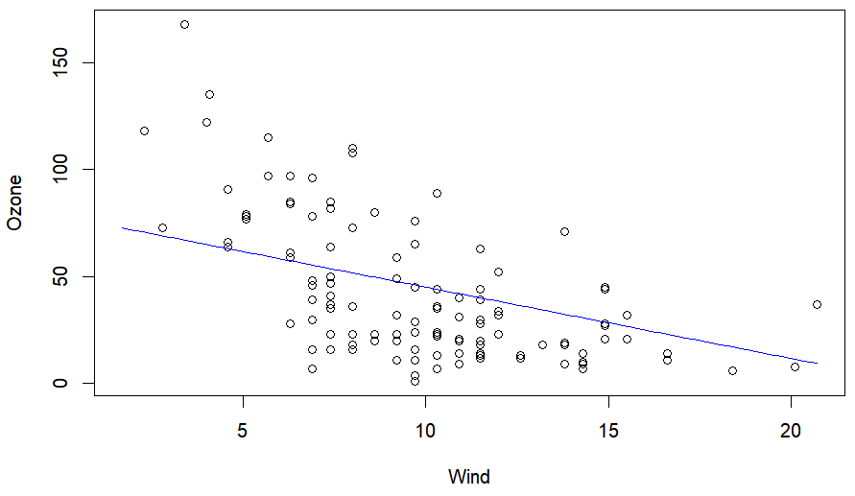
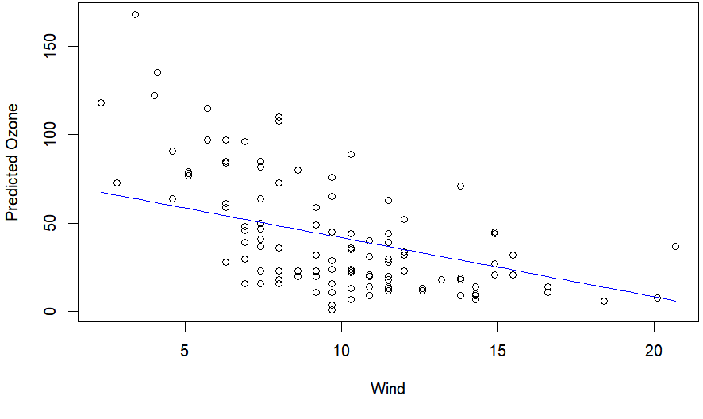
slice_2d:
A function that makes taking a slice from a high dimensional model easier (Base R)
Before:
After:

Slide 9

geom_slice

Slide 10
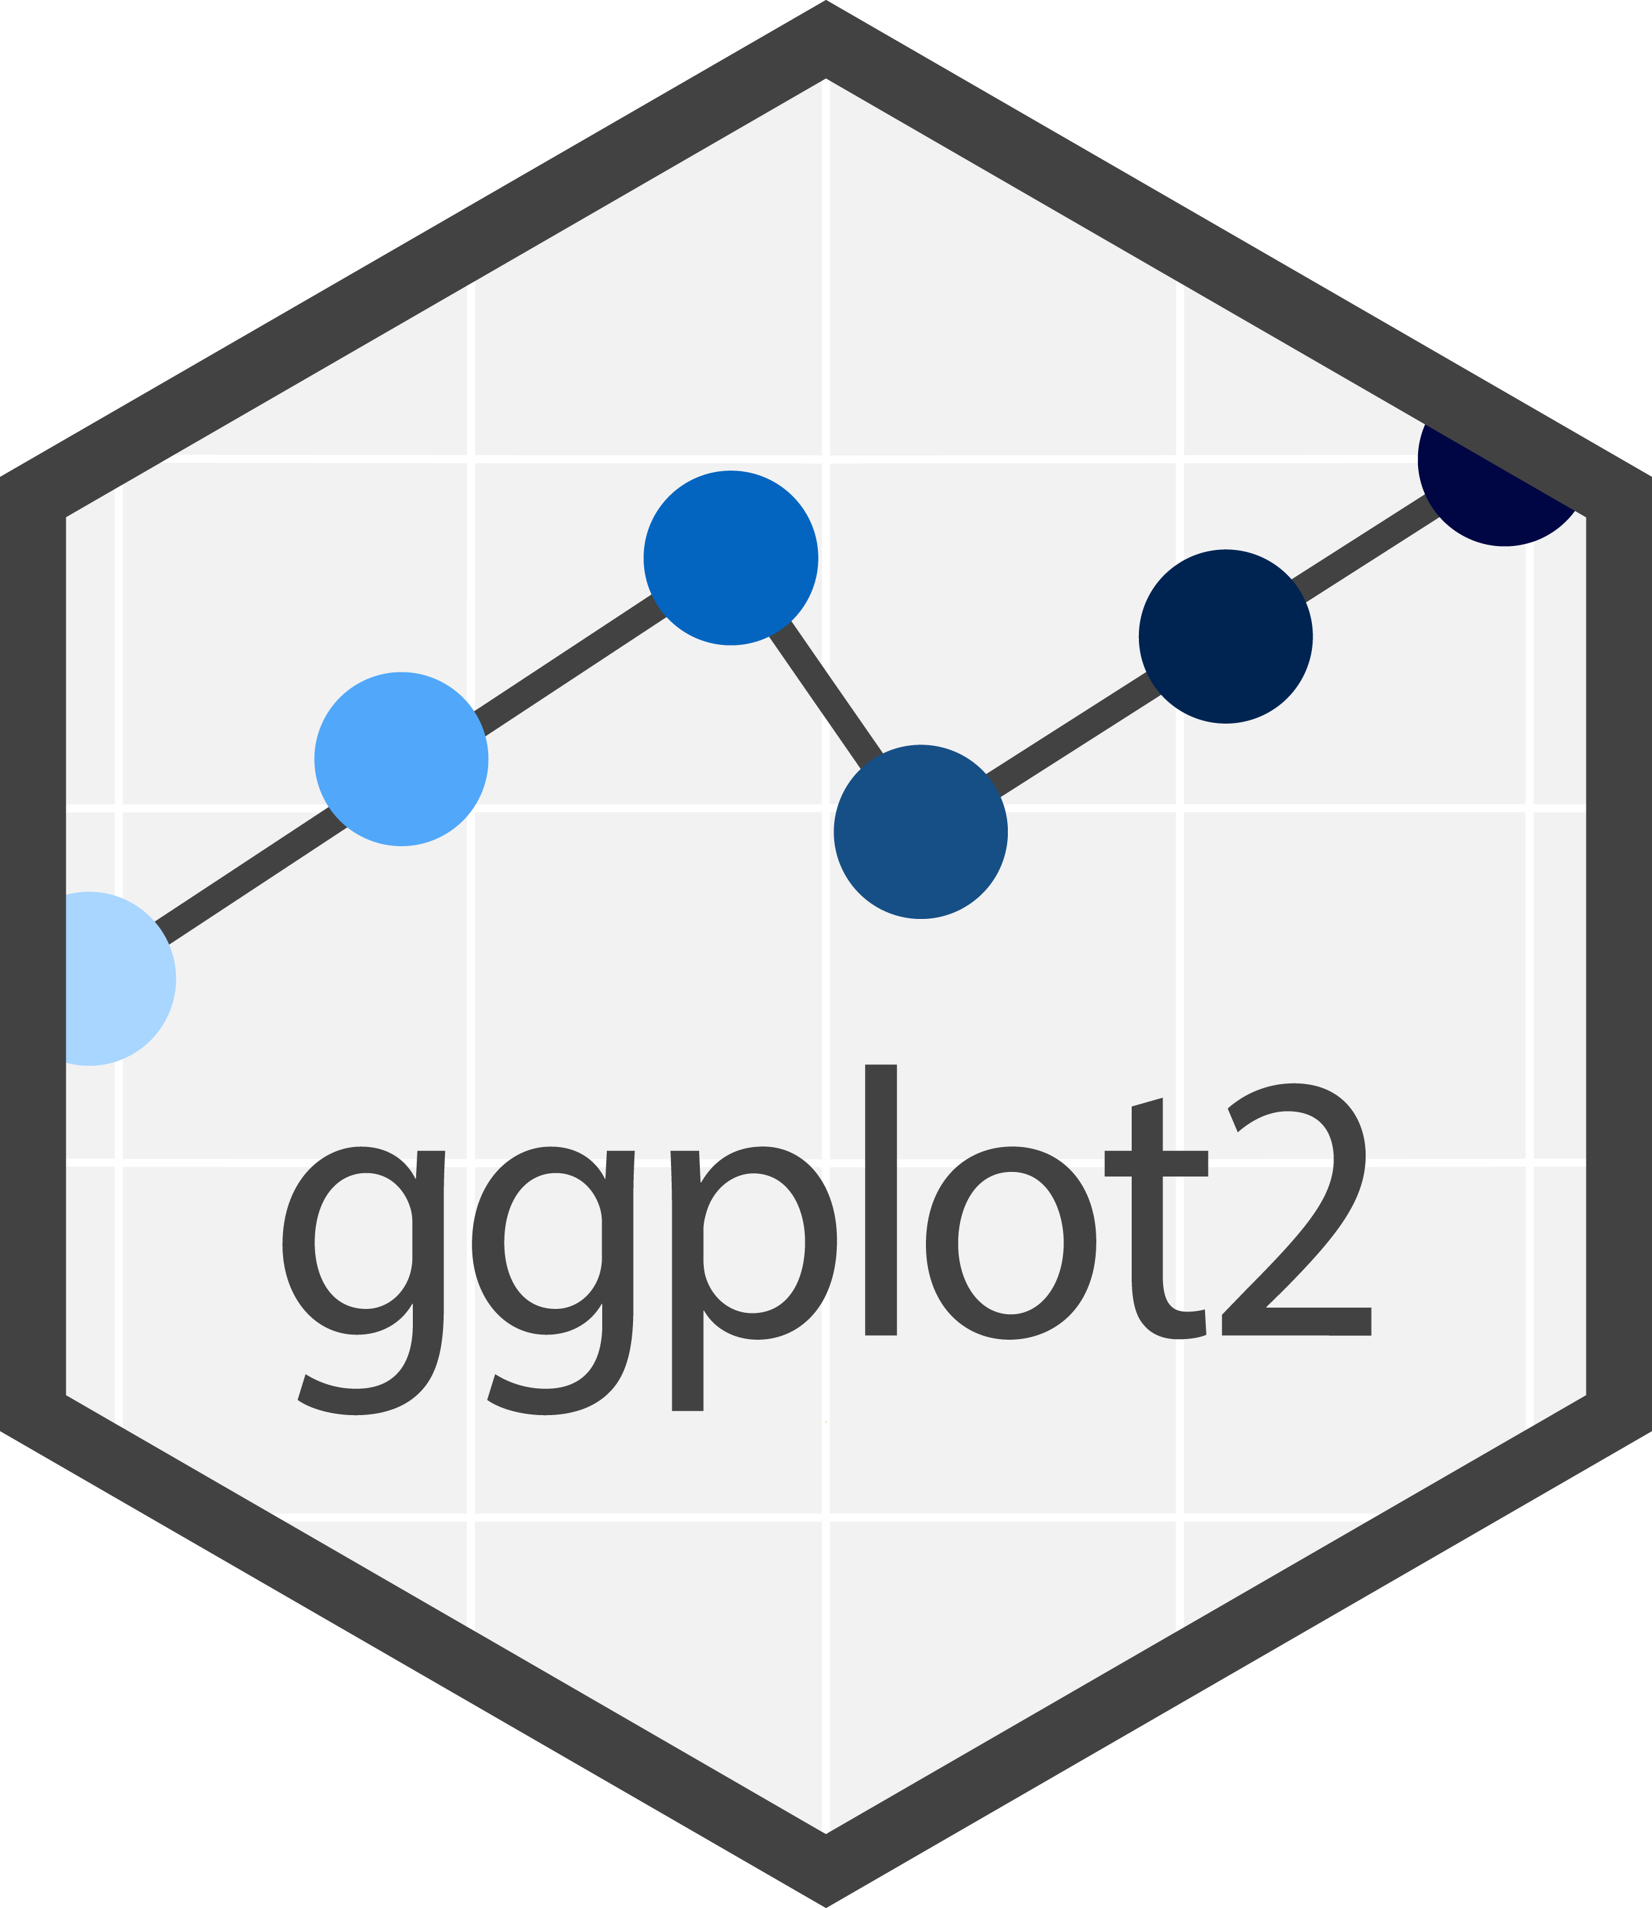
From Simple Idea to Deep Dive
Initial goal: recreate the function of slice_2d in ggplot
“This should be easy”
A deep dive into the innerworkings of ggplot would be necessary

Slide 11



Understanding ggplot
Connected with Hadley Wickham and other prominent figures at Posit
ggproto
An objected-oriented system
“Powers” ggplot
Forms environments for formatting data
Uses functions like compute_group, compute_panel, and compute_layer

Slide 12
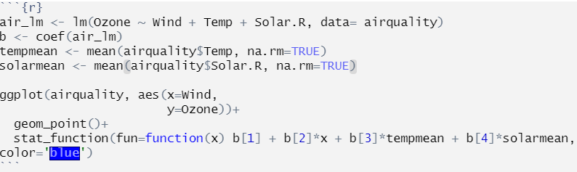
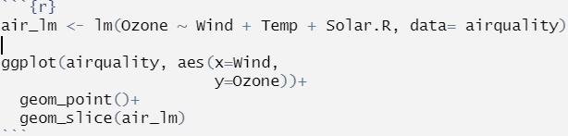
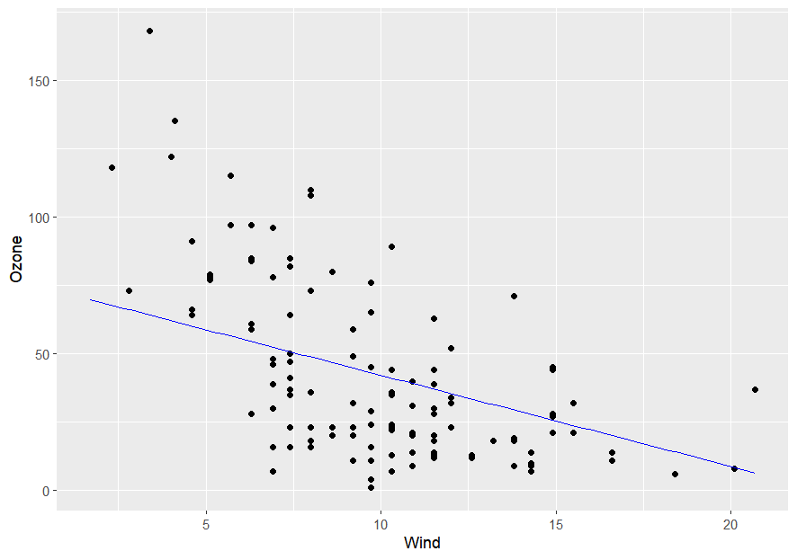
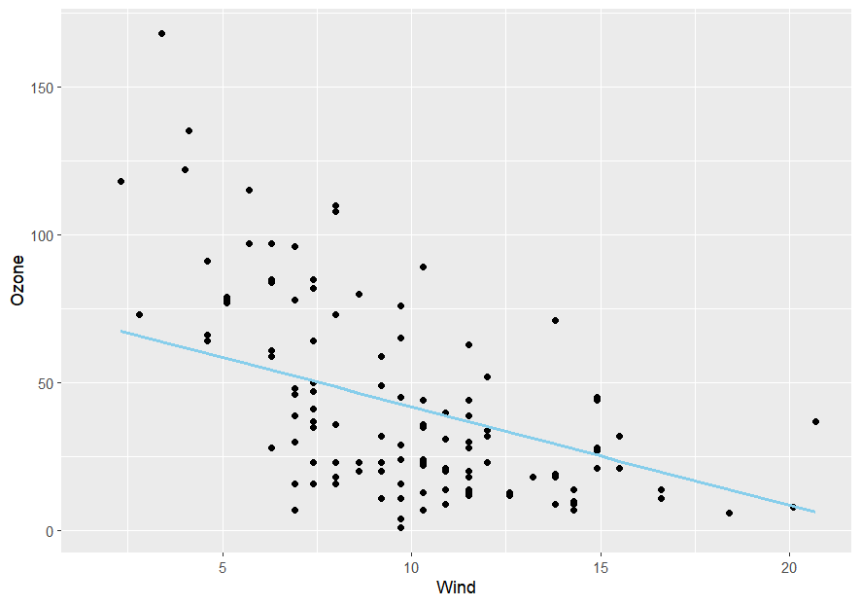
A Working Function
Before:
After:

Slide 13
WORKTIME

Slide 14
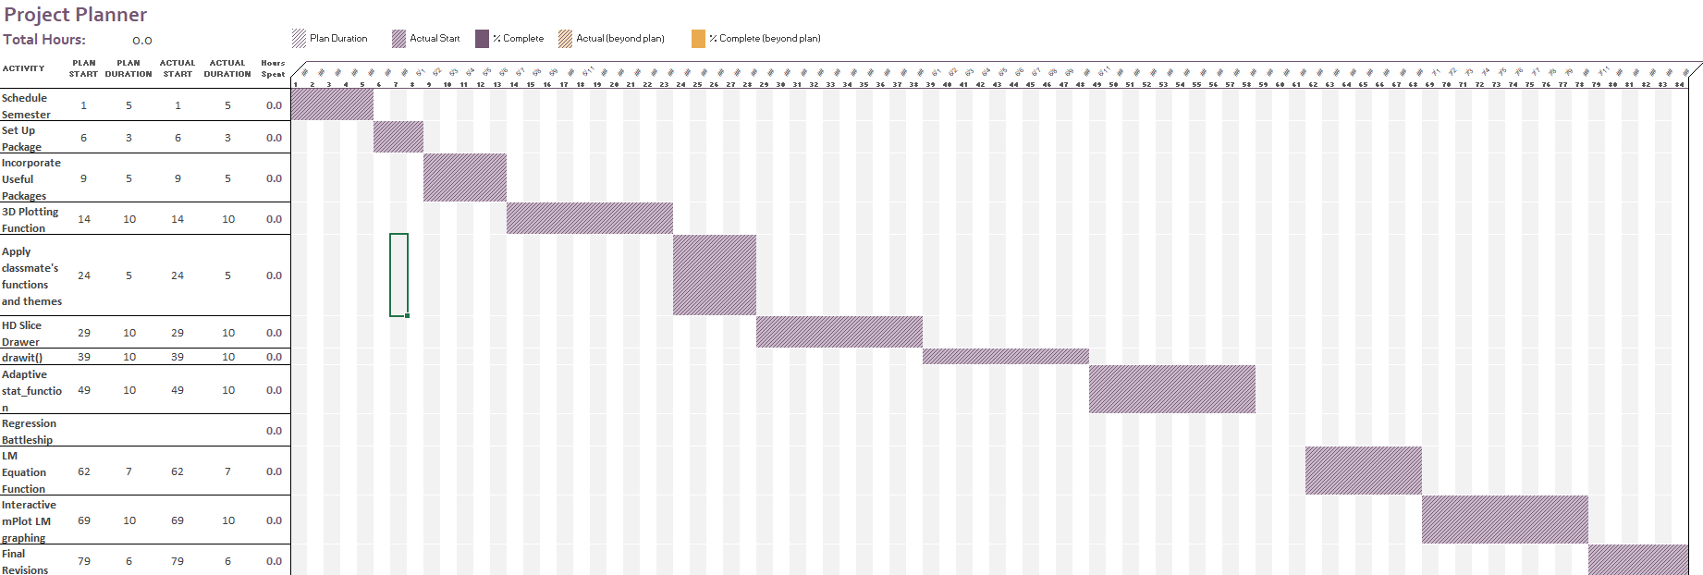
Predicted

Slide 15
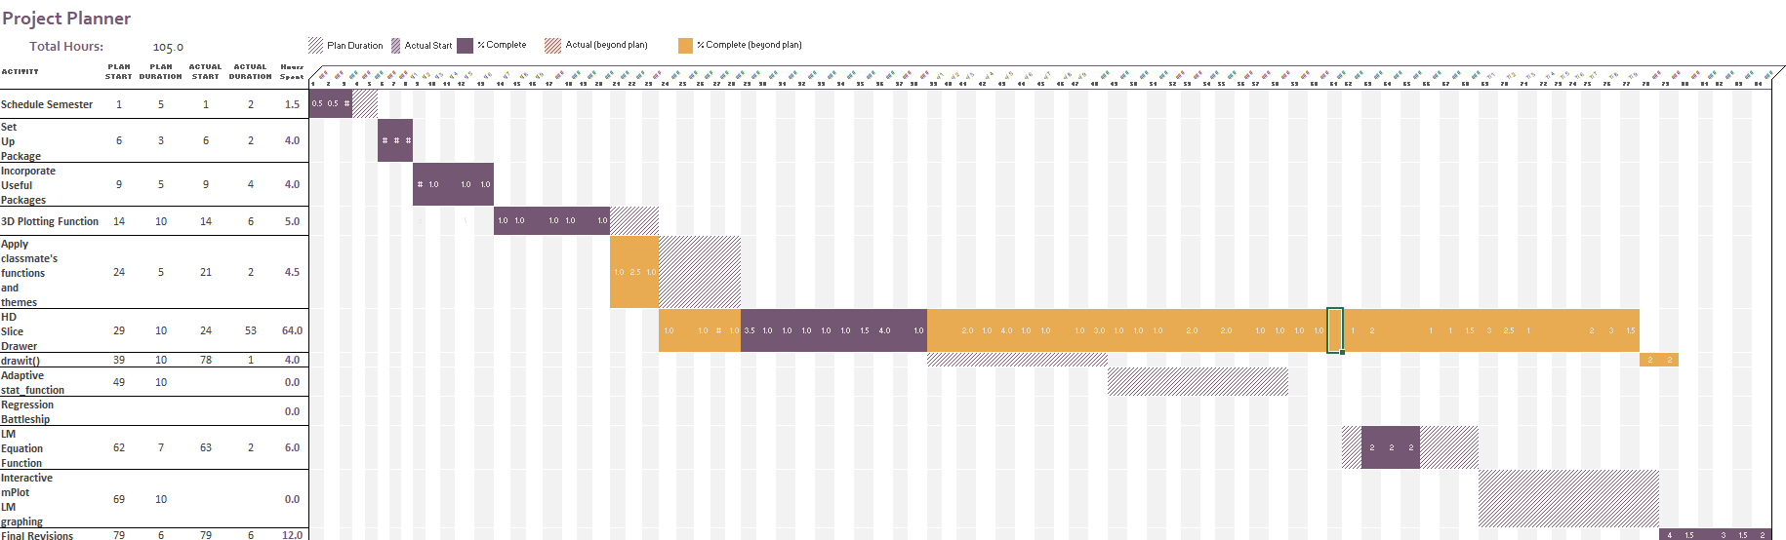
Actual

Slide 16
Recognitions
Lauren Condie – the inspiration for theme_lc was taken from Lauren Condie’s work, hence the name: theme_lc
James Beeson – inspiration for geom_slice was taken from James’ work before diving deeper into the ggplot and ggproto
Christian Haroldsen – creator of the Applr logo

Slide 17
THANKS

